Slide 1
Chapter 9
Path Testing–Part 1

Slide 2
Structural (Code-Based) Testing
Complement of/to Functional Testing
Based on Implementation
Powerful mathematical formulation
program graph
define-use path
Program slices
Basis for Coverage Metrics (a better answer for gaps and redundancies)
Usually done at the unit level
Not very helpful to identify test cases
Extensive commercial tool support

Slide 3
Path Testing
Paths derived from some graph construct.
When a test case executes, it traverses a path.
Huge number of paths implies some simplification is needed.
Big Problem: infeasible paths.
Big Question: what kinds of faults are associated with what kinds of paths?
By itself, path testing can lead to a false sense of security.

Slide 4
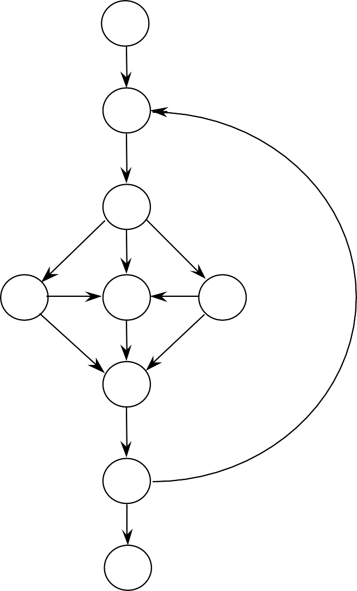
The Common Objection: Trillions of Paths
ﬁrst
If the loop executes up to 18 times, there are 4.77 Trillion paths.
(5¹⁸ = 3,814,697,265,625)
(Actually, it is 4,768,371,582,030 paths)
What who would ever test all of these?
We will have an elegant, mathematically sensible alternative
A
B
BUT
C
D
E
F
G
Stephen R. Schach, Software Engineering, (2nd edition) Richard D. Irwin, Inc. and Aksen Associates, Inc. 1993 (also in all later editions!)
last

Slide 5
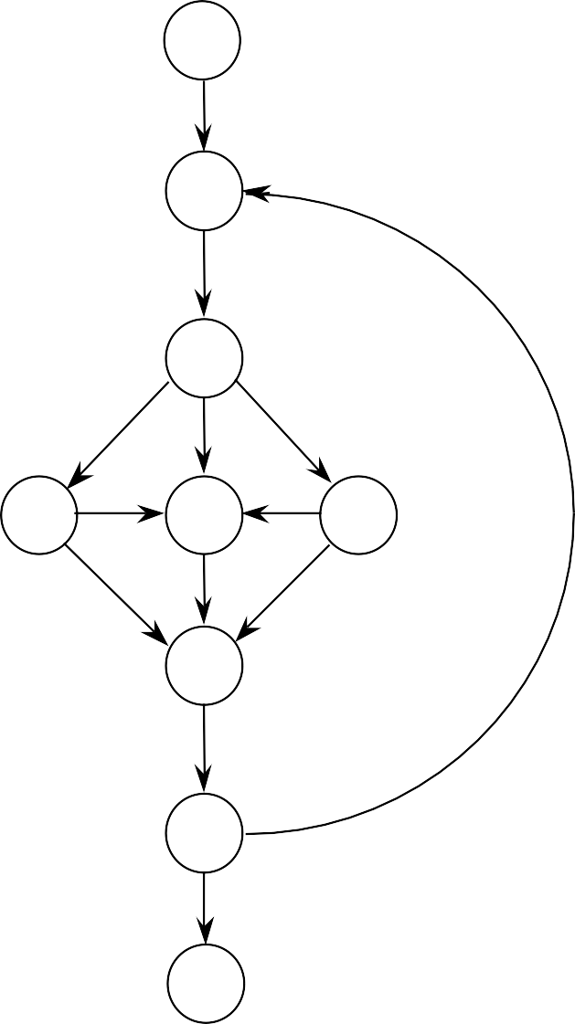
Test Cases for Schach’s “Program”
first
First-A-B-C-F-G-Last
First-A-B-C-D-F-G-Last
First-A-B-D-F-G-A-B-D-F-G-Last
First-A-B-E-F-G-Last
First-A-B-E-D-F-G-Last
A
B
These test cases cover
C
D
E
Every node
Every edge
Normal repeat of the loop
Exiting the loop
F
G
last

Slide 6
Program Graph Deﬁnitions
Given a program written in an imperative programming language, its program graph is a directed graph in which…
(Traditional Deﬁnition) nodes are program statements, and edges represent ﬂow of control (there is an edge from node i to node j iff the statement corresponding to node j can be executed immediately after the statement corresponding to node i).
(improved deﬁnition) nodes are either entire statements or fragments of a statement, and edges represent ﬂow of control (there is an edge from node i to node j iff the statement (fragment) corresponding to node j can be executed immediately after the statement or statement fragment corresponding to node i).

Slide 7
Program Graphs of Structured Programming Constructs
Sequence Pre-test Loop Post-test Loop
If-Then
If-Then-Else
Case

Slide 8
Triangle Program Speciﬁcation
Inputs: a, b, and c are non-negative integers, taken to be sides of a triangle
Output: type of triangle formed by a, b, and c
Not a triangle
Scalene (no equal sides)
Isosceles (exactly 2 sides equal)
Equilateral (3 sides equal)
To be a triangle, a, b, and c must satisfy the triangle inequalities:
a < b + c,
b < a + c, and
c < a + b

Slide 9
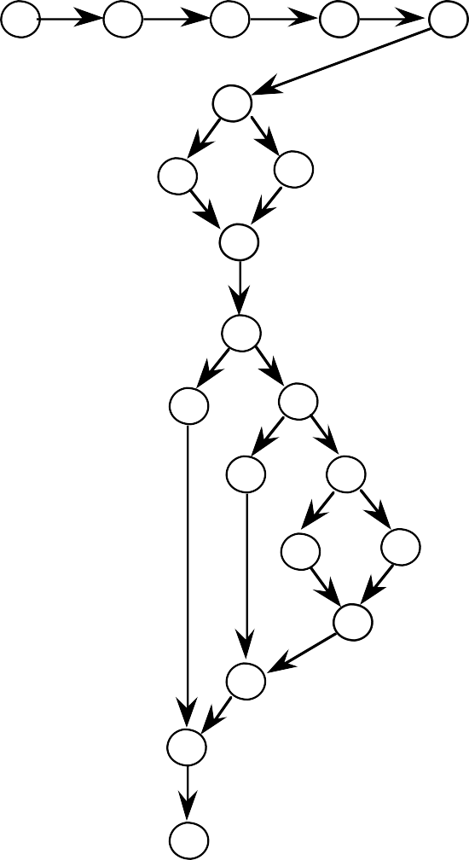
Sample Program Graph
Program triangle
Dim a,b,c As Integer
Dim IsATriangle As Boolean 'Step 1: Get Input
4
5
6
7
8
9
Output("Enter 3 integers which are sides of a triangle")
Input(a,b,c)
Output("Side A is ",a)
Output("Side B is ",b)
Output("Side C is ",c) 'Step 2: Is A Triangle?
If (a < b + c) AND (b < a + c) AND (c < a + b)
Then IsATriangle = True
Else IsATriangle = False
12 EndIf
'Step 3: Determine Triangle Type
13. If IsATriangle 14.
15.
16.
17.
18.
19.
20.
21.
22.
23.
10
11
12
13
21
14
15
16
Then
If (a = b) AND (b = c)
Then Output ("Equilateral")
17
18
Else
If (a ≠ b) AND (a ≠ c) AND (b ≠ c)
19
Then Else
EndIf
Output ("Scalene") Output ("Isosceles")
20
EndIf
Output("Not a Triangle")
22
Else EndIf
End triangle2
23

Slide 10
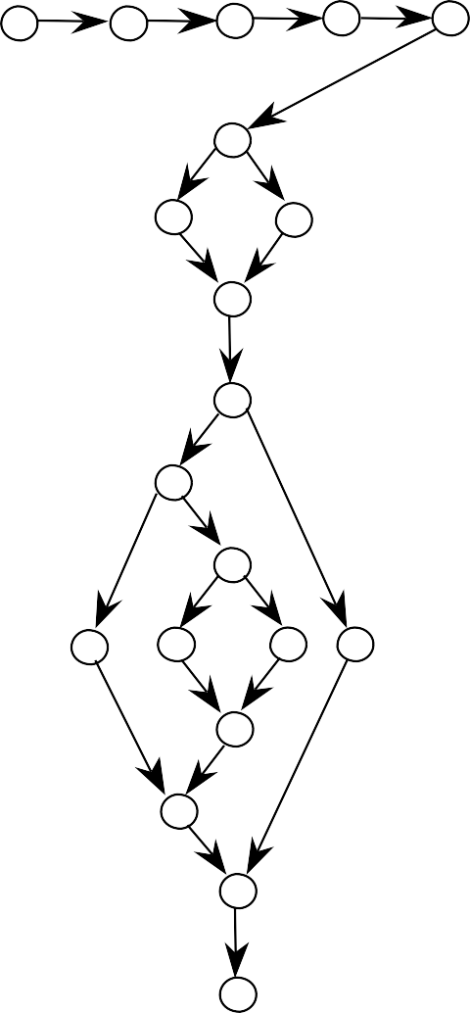
Trace Code for a = 5, b = 5, c = 5
Program Triangle
Dim a, b, c As Integer Dim IsATriangle As Boolean
1
2
3
4
5
'Step 1: Get Input
6
1.
Output ("Enter 3 integers of a triangle")
Input (a,b,c)
which
are sides
2.
3.
4.
5.
7
8
Output Output Output
("Side
("Side
("Side
is ",a)
is ",b)
is ",c)
9
'Step 2:
Is A Triangle?
If (a < b + c) AND (b < a b)
Then Else Endif
10
6.
+ c) AND (c < a +
7.
8.
9.
IsATriangle = True IsATriangle = False
11
13
'Step 3:
Determine Triangle Type
12
14
15
18
If IsATriangle
Then If (a = b) 12.
AND (b = c)
Then Output
Else If (a
16
(“Equilateral”)
c) AND (b ≠ c)
17
13.
≠ b) AND (a ≠
14.
Then
19
Output (“Scalene”) Output (“Isosceles”)
15.
Else
20
16.
Endif
17.
Endif
rd
Software Testing: A Craftsman’s Approach, 3
Edition
Path Testing I
18.
19. Endif
Else Output (“Not a Triangle”)

Slide 11
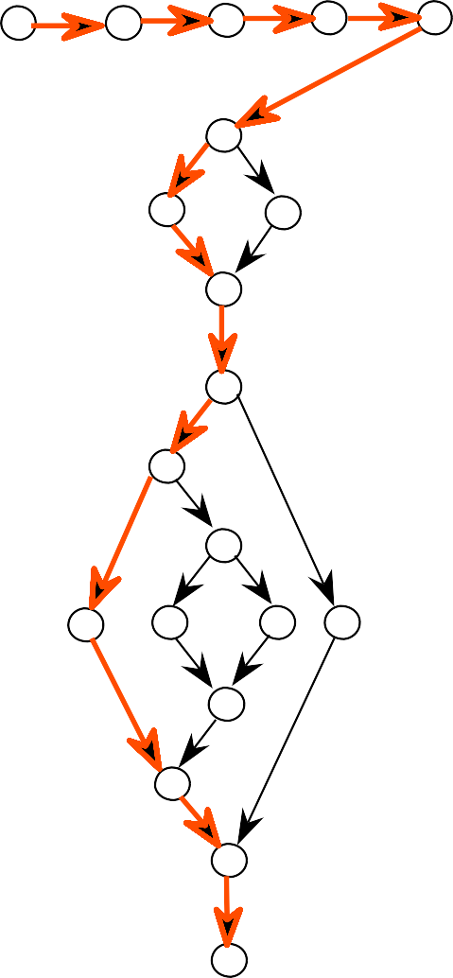
Trace Code for a = 5, b = 5, c = 5
Program Triangle
Dim a, b, c As Integer Dim IsATriangle As Boolean
1
2
3
4
5
'Step 1: Get Input
6
1.
Output ("Enter 3 integers of a triangle")
Input (a,b,c)
which
are sides
2.
3.
4.
5.
7
8
Output Output Output
("Side
("Side
("Side
is ",a)
is ",b)
is ",c)
9
'Step 2:
Is A Triangle?
If (a < b + c) AND (b < a b)
Then Else Endif
10
6.
+ c) AND (c < a +
7.
8.
9.
IsATriangle = True IsATriangle = False
11
13
'Step 3:
Determine Triangle Type
12
14
15
18
If IsATriangle
Then If (a = b) 12.
AND (b = c)
Then Output
Else If (a
16
(“Equilateral”)
c) AND (b ≠ c)
17
13.
≠ b) AND (a ≠
14.
Then
19
Output (“Scalene”) Output (“Isosceles”)
15.
Else
20
16.
Endif
17. Endif
Soft1w8a.re TesEtlinsge: AOCurtafptsumtan(’“sNAoptproaacTh,r3i^{rd}aEndgiltieon”)
Path Testing I
19. Endif

Slide 12

Trace Code for a = 2, b = 5, c = 5
Program Triangle
Dim a, b, c As Integer Dim IsATriangle As Boolean
1
2
3
4
5
'Step 1: Get Input
6
1.
Output ("Enter 3 integers of a triangle")
Input (a,b,c)
which
are sides
2.
3.
4.
5.
7
8
Output Output Output
("Side
("Side
("Side
is ",a)
is ",b)
is ",c)
9
'Step 2:
Is A Triangle?
< b + c) AND (b < a
10
6.
If (a
+ b) Then Else Endif
+ c) AND (c < a
7.
8.
9.
IsATriangle = True IsATriangle = False
11
13
'Step 3:
Determine Triangle Type
12
14
15
18
If IsATriangle
Then If (a = b) 12.
AND (b = c)
Then Output
16
(“Equilateral”)
17
13.
Else If (a
≠ b) AND (a ≠
c) AND
(b ≠ c)
19
14.
Then
Output
(“Scalene”)
15.
Else
20
Output
(“Isosceles”)
16.
17.
Endif
Endif
Softw1a8re.TestiEnlgs: eA COruafttspmuatn’s(“ANpoprtoaach,T3r^{rd}iEadnitgiolne”)
19.
Endif

Slide 13
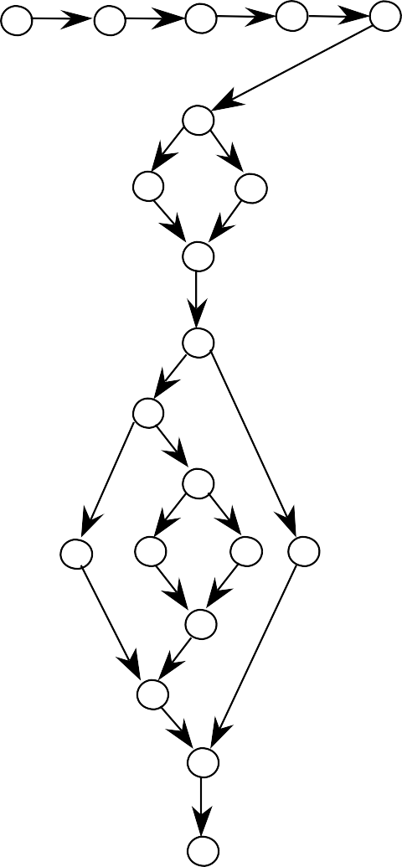
Trace Code for a = 3, b = 4, c = 5
Program triangle
Dim a, b, c As Integer Dim IsATriangle As Boolean
1
2
3
4
5
'Step 1: Get Input
6
1.
Output ("Enter 3 integers of a triangle")
Input (a,b,c)
which
are sides
2.
3.
4.
5.
7
8
Output Output Output
("Side
("Side
("Side
is ",a)
is ",b)
is ",c)
9
'Step 2:
Is A Triangle?
< b + c) AND (b < a
10
6.
If (a
+ b) Then Else Endif
+ c) AND (c < a
7.
8.
9.
IsATriangle = True IsATriangle = False
11
13
'Step 3:
Determine Triangle Type
12
14
15
18
If IsATriangle
Then IF (a = b) 12.
AND (b = c)
Then Output
16
(“Equilateral”)
17
13.
Else If (a
≠ b) AND (a ≠
c) AND
(b ≠ c)
19
14.
Then
Output
(“Scalene”)
15.
Else
20
Output
(“Isosceles”)
16.
17.
Endif
Endif
Softw¹a⁸re.Test^{E}in^{l}g^{s}: ^{e}A C^{O}r^{u}a^{t}ft^{p}sm^{ut}an’⁽s“A^{N}pºp^{t}roaªch^{T}, 3^{rrid a}Ed^{n}i^{g}ti^{l}on^{e”)}
19. Endif

Slide 14

Trace Code for a = 2, b = 3, c = 7
Program triangle
Dim a, b, c As Integer Dim IsATriangle As Boolean
1
2
3
4
5
'Step 1: Get Input
6
1.
Output ("Enter 3 integers of a triangle")
Input (a,b,c)
which
are sides
2.
3.
4.
5.
7
8
Output Output Output
("Side
("Side
("Side
is ",a)
is ",b)
is ",c)
9
'Step 2:
Is A Triangle?
< b + c) AND (b < a
10
6.
If (a
+ b) Then Else Endif
+ c) AND (c < a
7.
8.
9.
IsATriangle = True IsATriangle = False
11
13
'Step 3:
Determine Triangle Type
12
14
15
18
If IsATriangle
Then IF (a = b) 12.
AND (b = c)
Then Output
16
(“Equilateral”)
17
13.
Else If (a
≠ b) AND (a ≠
c) AND
(b ≠ c)
19
14.
Then
Output
(“Scalene”)
15.
Else
20
Output
(“Isosceles”)
16.
17.
Endif
Endif
So¹ft⁸w.are Te^{E}s^{l}ti^{s}n^{e}g: A^{Ou}C^{t}ra^{p}f^{u}ts^{t}ma⁽n“’s^{No}A^{t}pprªoa^{T}ch^{r},^{i}3^{ardn}E^{g}d^{l}it^{e}io”n⁾
19. Endif

Slide 15

path traverses nodes 7 and 18?
Can you ﬁnd values of a, b, and c such that the
Program triangle
Dim a, b, c As Integer Dim IsATriangle As Boolean
1 2 3 4
5
'Step 1: Get Input
6
1.
Output ("Enter 3 integers of a triangle")
Input (a,b,c)
which
are sides
7
8
2.
3.
4.
5.
Output Output Output
("Side
("Side
("Side
is ",a)
is ",b)
is ",c)
9
'Step 2:
Is A Triangle?
If (a < b + c) AND (b < b)
Then Else Endif
10
6.
a + c) AND (c < a +
11
7.
8.
9.
IsATriangle IsATriangle
= True
= False
13
'Step 3:
Determine Triangle Type
12
14
15
18
If IsATriangle
Then IF (a = b) 12.
AND (b = c)
Then Output
Else If (a
16
(“Equilateral”)
c) AND (b ≠ c)
17
13.
≠ b) AND (a ≠
19
14.
Then
Output (“Scalene”) Output (“Isosceles”)
20
15.
Else
16.
Endif
Softwa1re7.Testing: A Craftsman’EsnAdpipfroach, 3rd Edition
18.
Else Output (“Not a Triangle”)

Slide 16
DD-Paths
A DD-Path (decision-to-decision) is a chain in a program graph such that Case 1: it consists of a single node with indegree = 0, or
Case 2: it consists of a single node with outdegree = 0, or
Case 3: it consists of a single node with indegree >= 2 or outdegree >= 2, or
Case 4: it consists of a single node with indegree = 1 and outdegree = 1, or Case 5: it is a maximal chain of length >= 1.
Initial Node
Interior Nodes
Terminal Node
a 2-connected chain

Slide 17
DD-Path Graph
Given a program written in an imperative language, its DD-Path graph is the directed graph in which nodes are DD-Paths of its program graph, and edges represent control flow between successor DD-Paths.
a form of condensation graph
2-connected components are collapsed into an individual node
single node DD-Paths (corresponding to Cases
1 - 4 ) preserve the convention that a statement fragment is in exactly one DD-Path

Slide 18
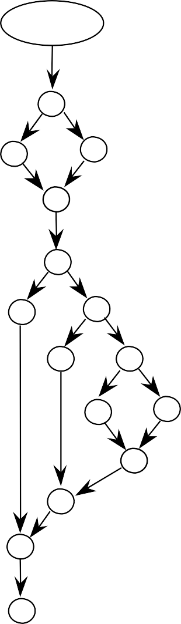

DD-Path Graph
(not much compression because this example is control intensive, with little sequential code.)
DD-Path 1
4
5
6
7
8
9
9
10
12
11
10
12
11
13
13
21
14
21
14
15
16
15
16
17
18
17
18
19
20
22
19
20
22
23
23

Slide 19
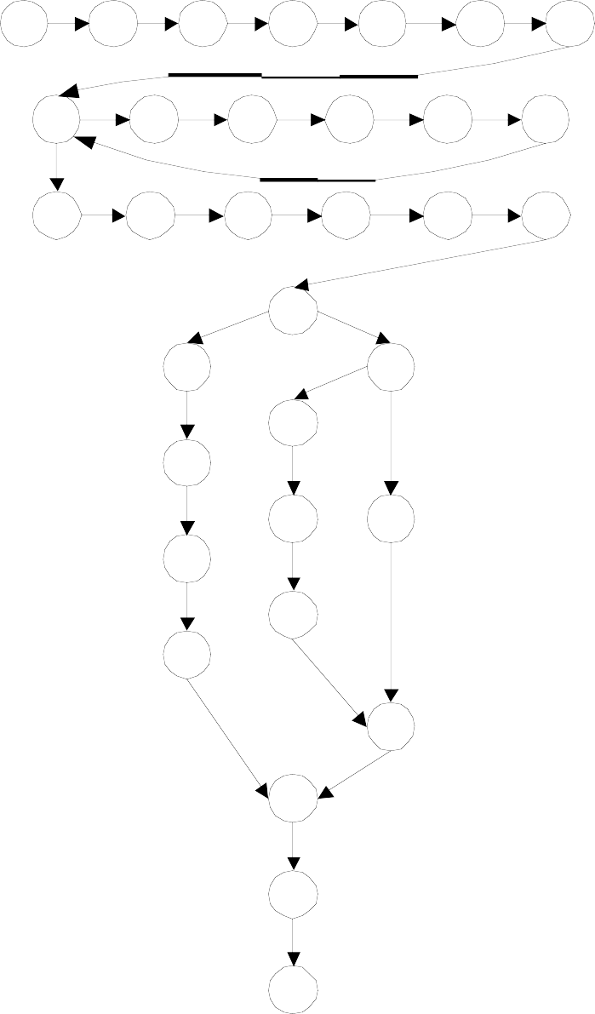
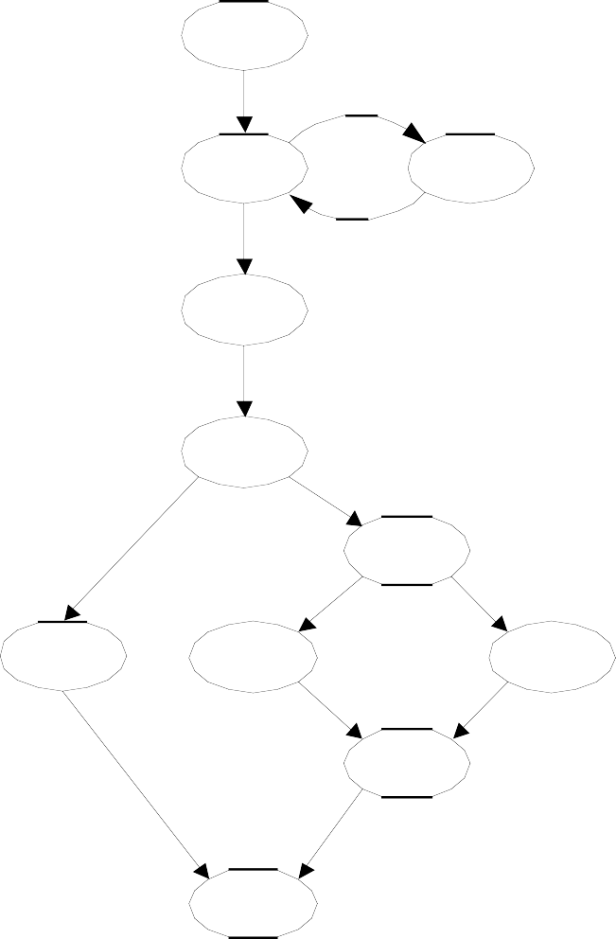
1
2
3
4
5
6
7
DD-Path Graph of Commission Problem
1 - 7
8
9
10
11
12
13
14
15
16
17
18
19
20
8
9 – 13
(better example of DD-Path compression)
21
25
26
14 - 19
22
27
29
23
20
28
25
24
30
21 - 24
26 - 28
29
31
30
32
31 - 33
33

Slide 20
Structural Test Coverage Metrics
(E. F. Miller, 1977 dissertation)
C₀: Every statement
C₁: Every DD-Path
C_{1p}: Every predicate outcome
C₂: C₁ coverage + loop coverage
C_{d}: C₁ coverage +every pair of dependent DD-Paths
C_{MCC}: Multiple condition coverage
C_{ik}: Every program path that contains up to k repetitions of a loop (usually k = 2)
C_{stat}: "Statistically significant" fraction of paths
C∞: All possible execution paths

Slide 21
Graph-Based Coverage Metrics
Every node
Every edge
Successive pairs of edges
Every path
Exercise: How do these compare with structural test coverage metrics?

Slide 22
Testing Loops
Huang's Theorem: (Paraphrased)
Everything interesting will happen in two loop traversals: the normal loop traversal and the exit from the loop.
Exercise:
Discuss Huang's Theorem in terms of graph based coverage metrics.

Slide 23
Concatenated, Nested, and Knotted Loops
ﬁrst
ﬁrst
ﬁrst
A
A
A
B
B
B
C
C
C
D
D
D
last
last
last

Slide 24
Strategy for Loop Testing
Huang’s theorem suggests/assures 2 tests per loop is sufficient. (Judgment required, based on reality of the code.)
For nested loops:
Test innermost loop first
Then “condense” the loop into a single node (as in condensation graph, see Chapter 4)
Work from innermost to outermost loop
For concatenated loops: use Huang’s Theorem
For knotted loops: Rewrite! (see McCabe’s cyclomatic complexity)

Slide 25
Multiple Condition Testing
Consider the multiple condition as a logical proposition, i.e., some logical expression of simple conditions.
Make the truth table of the logical expression.
Convert the truth table to a decision table.
Develop test cases for each rule of the decision table (except the impossible rules, if any).
Next 3 slides: multiple condition testing for
If (a < b + c) AND (b < a + c) AND (c < a + b) Then IsATriangle = True
Else IsATriangle = False Endif

Slide 26
Truth Table for
(a<b+c) AND (b<a+c) AND (c<a+b)
(a<b+c) | (b<a+c) | (c<a+b) | (a<b+c) AND (b<a+c) AND (c<a+b)
T | T | T | T
T | T | F | F
T | F | T | F
T | F | F | F
F | T | T | F
F | T | F | F
F | F | T | F
F | F | F | F

Slide 27
Decision Table for
(a<b+c) AND (b<a+c) AND (c<a+b)
c1: a<b+c | T | T | T | T | F | F | F | F
c2: b<a+c | T | T | F | F | T | T | F | F
c3: c<a+b | T | F | T | F | T | F | T | F
a1: impossible |  |  |  | X |  | X | X | X
a2:Valid test case # | 1 | 2 | 3 |  | 4

Slide 28
Multiple Condition Test Cases for
(a<b+c) AND (b<a+c) AND (c<a+b)
Test Case |  | a | b | c | expected output
1 | all true | 3 | 4 | 5 | TRUE
2 | c ≥ a + b | 3 | 4 | 9 | FALSE
3 | b ≥ a + c | 3 | 9 | 4 | FALSE
4 | a ≥ b + c | 9 | 3 | 4 | FALSE
Note: could add test cases for c = a + b, b = a + c, and a = b + c.

Slide 29
Exercise: What test cases are needed for this code fragment ?
13. If (a ≠ b) AND (a ≠ c) AND (b ≠ c)
14.
15.
Then Output (“Scalene”) Else Output (“Isosceles”)
16. Endif
a b
c
Expected Output

Slide 30
Dependent DD-Paths
(often correspond to infeasible paths)
Look at the Triangle Program code in slide 8
And the program graph and DD-Path graph in slide 11
If a path traverses node 10 (Then IsATriangle = True), then it must traverse node 14.
Similarly, if a path traverses node 11 (Else IsATriangle = False), then it must traverse node 21.
Paths through nodes 10 and 21 are infeasible.
Similarly for paths through 11 and 14.
Hence the need for the C_{d} coverage metric.

Slide 31
Code-Based Testing Strategy
Start with a set of test cases generated by an “appropriate” (depends on the nature of the program) specification-based test method.
Look at code to determine appropriate test coverage metric.
Loops?
Compound conditions?
Dependencies?
If appropriate coverage is attained, fine.
Otherwise, add test cases to attain the intended test coverage.

Slide 32
Test Coverage Tools
Commercial test coverage tools use “instrumented” source code.
New code added to the code being tested
Designed to “observe” a level of test coverage
When a set of test cases is run on the instrumented code, the designed test coverage is ascertained.
Strictly speaking, running test cases in instrumented code is not sufficient
Safety critical applications require tests to be run on actual (delivered, non-instrumented) code.
Usually addressed by mandated testing standards.

